Slide 1
The E-ARK Project
Initial Maturity Model for Information Governance Arrangements in Organizations
European Archival Records and Knowledge Preservation
A Worskhop for INFuture 2015
Janet Delve – University of Portsmouth
Diogo Proença - Instituto Superior Técnico -
Universidade de Lisboa

Slide 2
Outline
Background to the E-ARK Project
  The Background to E-ARK
  What is the project delivering ?
  What have we done so far ?
  How to keep up with E-ARK ?
The E-ARK Maturity Model for Information Governance Arrangements
Questions

Slide 3
Introducing the e-ark project

Slide 4
About Project E-ARK
E-ARK is a 3-year multinational research project co-funded by the European Commission under its ICT Policy Support Programme (PSP) within its Competitiveness and Innovation Framework Programme (CIP).
E-ARK runs from 1st February 2014 to 31st January 2017
The goal of the E-ARK Project is to pilot archival services to keep records authentic and usable based on current best-practices. These will address the three main endeavours of an archive – acquiring, preserving and enabling re-use of information.
E-ARK brings together a core group of European national archives, four leading research institutions, three providers of archiving software solutions and services, two government agencies, and two international membership organizations that represent the communities who stand to benefit from the project: data owners/providers, archives, software vendors and solution providers.

Slide 5
Project Partners in E-ARK
University of Portsmouth Higher Education Corporation (E-ARK Project Co-Ordinator)
AIT Austrian Institute of Technology GmbH
Archives of the Republic of Slovenia - Arhiv Republike Slovenije
The DLM Forum Foundation
Statens Arkiver: The Danish National Archives
The Digital Preservation Coalition
Universität zu Köln: The University of Cologne
Instituto Superior Técnico - Lisbon Technical University
The National Archives of Hungary
Rahvusarhiiv: The National Archives of Estonia
Arkivverket: National Archival Services of Norway
ES Solutions (Sweden)
Magenta (Denmark)
KEEP Solutions LDA (Portugal)
Agência para a Modernização Administrativa IP - Agency for Public Services Reform, IP (Portugal)
Ministerio de Hacienda y Administraciones Pública - The Ministry of Finances and Public Administrations (Spain)

Slide 6
Objectives of the project E-ARK
E-ARK will create and pilot a pan-European methodology for electronic document archiving, gathering existing national and international best practices, that will keep records and databases authentic and usable over time.
  Methodology - will be implemented in an open pilot in various national contexts, using existing, near-to-market tools, and services developed by the partners
  Workflow - will demonstrate the potential benefits for public administrations, public agencies, public services, citizens and business by providing simple, efficient access to the workflows for the three main activities of an archive - acquiring, preserving and enabling re-use of information.
  Infrastructure - project results will be generic and scalable in order to build an archival infrastructure across the EU and in environments where different legal systems and records management traditions apply.
  Open Source e-archival Service - will pilot an end-to-end OAIS-compliant e-archival service covering ingest, vendor-neutral archiving, and reuse of structured and unstructured data, thus covering both databases and records, addressing the needs of data subjects, owners and users.
  Pilots - pilots will run in several national archives, each of which will provide data to run in the pilot instance by agreement from an associated government data owner (e.g. national or regional / federal).
  Open Project Results - to sustain the outputs of our project, project partner The DLM Forum will ensure these. National archives running E-ARK pilot instances will serve as exemplars for others wanting to adopt up the new e-archiving open system.
Notes:
Main Objective - In co-operation with commercial systems providers, E-ARK will create and pilot a pan-European methodology for electronic document archiving, synthesising existing national and international best practices, that will keep records and databases authentic and usable over time.
Methodology - will be implemented in an open pilot in various national contexts, using existing, near-to-market tools, and services developed by the partners. This will allow memory institutions and their clients (public- and private-sector) to assess, in an operational context, the suitability of those state-of-the-art technologies.
Workflow - provide a single, scalable, robust approach capable of meeting the needs of diverse organisations, public and private, large and small, and able to support complex data types. E-ARK will demonstrate the potential benefits for public administrations, public agencies, public services, citizens and business by providing simple, efficient access to the workflows for the three main activities of an archive - acquiring, preserving and enabling re-use of information.
Infrastructure - The practices developed within the project will reduce the risk of information loss due to unsuitable approaches to keeping and archiving of records. The project will be public facing, providing a fully operational archival service, and access to information for its users. The project results will be generic and scalable in order to build an archival infrastructure across the EU and in environments where different legal systems and records management traditions apply. E-ARK will provide new types of access for business users.
Open Source e-archival Service - E-ARK will pilot an end-to-end OAIS-compliant e-archival service covering ingest, vendor-neutral archiving, and reuse of structured and unstructured data, thus covering both databases and records, addressing the needs of data subjects, owners and users. The pilot and methodology will also focus on the essential pre-ingest phase of data export and normalisation in source systems. The pilot will integrate tools currently in use in partner organisations, and provide a framework for providers of these and similar tools ensuring compatibility and interoperability. A core component of the project is the integration platform which uses the existing ESSArch Preservation Platform (EPP) application as an Archival Information System, which is already in productive deployment at the National Archives of Norway and Sweden. In order to achieve scalability, E-ARK will adopt a data management and storage layer for this tool on top of the proven open-source Cloudera CDH4 distribution of Apache Hadoop, enabling storage and computational power to be seamlessly added to the system.
Pilots - The pilot will run in several national archives, each of which will provide data to run in the pilot instance by agreement from an associated government data owner (e.g. national or regional / federal).
Open Project Results - To sustain the outputs of our project, project partner The DLM Forum, comprising 22 national archives and associated commercial and technical providers, is well placed to ensure these. Using the open Apache licensing model, commercial suppliers will be able to incorporate the project outputs (particularly the open interfaces for pre-ingest, ingest, archival, access and re-use) into their own systems, enhancing their longevity. National archives running E-ARK pilot instances will serve as exemplars for others wanting to adopt up the new e-archiving open system.
In addition, project partner, The Digital Preservation Coalition will promote best practices in this area, as will our dedicated government institution partners.

Slide 7
Knowledge centre:
Recommended practices for archival in the public sector
Our Workpackages
Technical evaluation
WP7
Business evaluation
Pilot scenarios
Pilot data
Submission / ingest workflow
Query / re-use workflow
Maturity model
WP6
WP2
Integrated pilot platform
Legal issues
Recommended SIP structure/interface
Recommended AIP structure/interface
Recommended DIP structure/interface
Analysis of practices for ingest
Analysis of practices for preservation
Analysis of practices for
re-use
Use cases
WP3
WP4
WP5

Slide 8
Our Milestones





Slide 9
Deliverables Year 1









Slide 10
Deliverables Year 2






Slide 11
Deliverables Year 3

Slide 12
How to find out more about e-ark

Slide 13
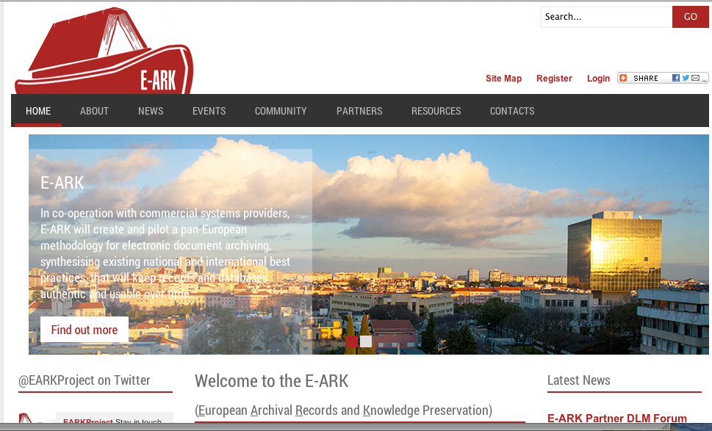
Website www.eark-project.eu

Slide 14
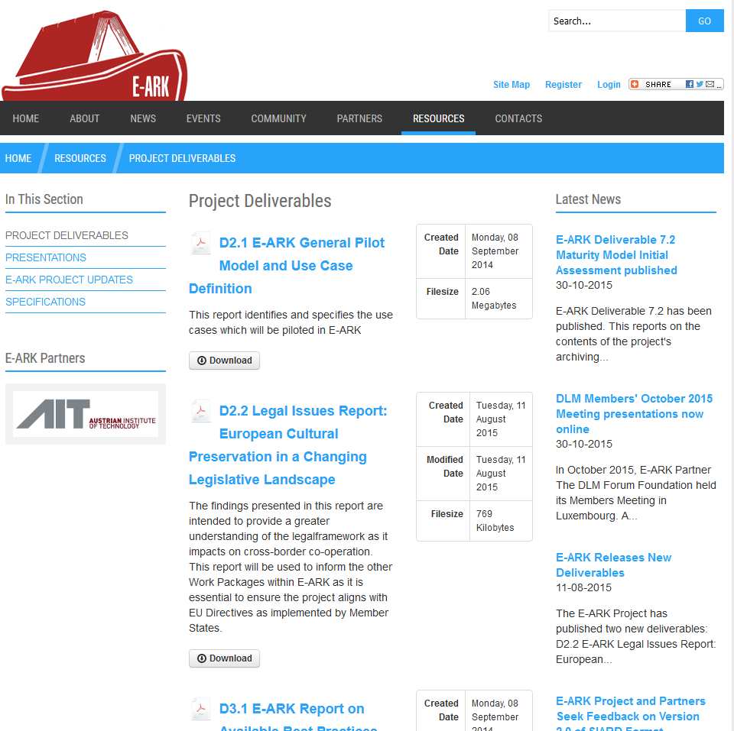
Website: Resources www.eark-project.eu

Slide 15
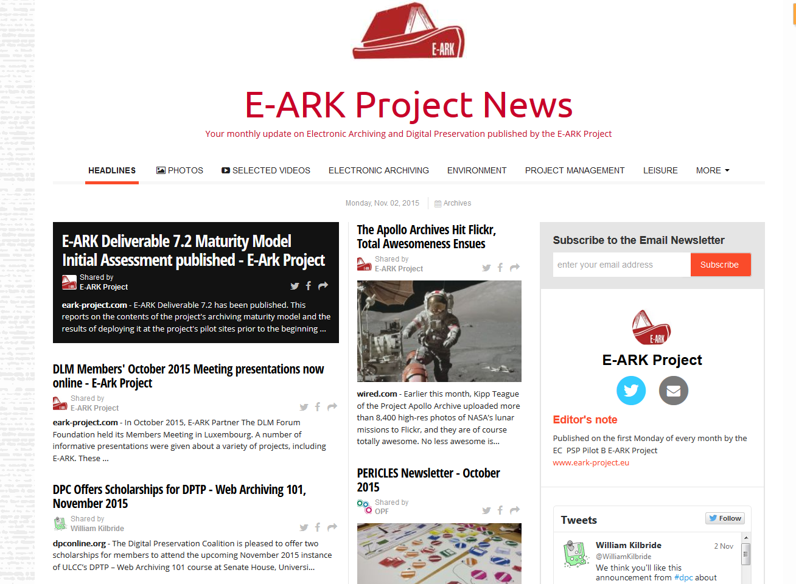
The E-ARK Monthly Newsletter news.eark-project.eu

Slide 16
How can I learn more about E-ARK
General public information about project E-ARK
Project website - http://eark-project.eu/
Project pressrelease - http://www.port.ac.uk/uopnews/2014/02/04/e-ark-gets-6m-to-save-our-digital-data/
Join our bulletin mailing list - http://bit.ly/earklist
Follow us on Twitter - @EARKProject
National contacts for more information:
Björn Skog bjorn@essolutions.se
Karin Bredenberg karin.bredenberg@riksarkivet.se
Notes:
The E-ARK project will be holding regular events as well as publishing newsletters and research papers.
We will also keep our user communities informed as we publish the outputs of our Project.
If you would like to be kept informed about developments in the project, click here to be added to a Mailchimp e-mail bulletin list which we will use to send out regular bulletins about the project.
This list will be used solely for purposes related to the E-ARK Project.
You can unsubscribe from this list at any time.

Slide 17
Fundamentals of Maturity Models

Slide 18
Maturity Model - Concept
A Maturity Model is a technique that is proved to be valuable to measure a certain aspect of an organization. It represents a path towards increasingly organized and systematic way of “doing things” in organizations.
Notes:
Mature: maturidade

Slide 19
Maturity Model - Concept
Typical Maturity Models are Staged Models consisting of a set of maturity levels (the number of maturity levels is specific of each model)
Each maturity level can be decomposed in:
  Dimensions and sub-dimensions;
  Elements;
  Attributes;
  Etc.

Slide 20
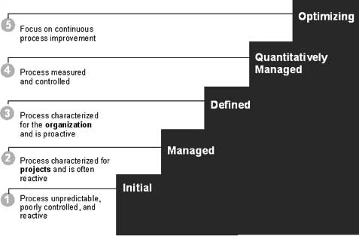
Maturity Model - Concept
(D. M. Ahern, A. Clouse, R. Turner. “CMMI Destilled: A Pratical Introduction to Integrated Process Improvement, Third Edition”. Addson Wesley Professional, 2008.)
Notes:
Mature: maturidade

Slide 21
Maturity Model - Motivation
It can provide information for benchmarking and internal auditing;
It can support measuring of progress (assessment);
It can help identifying strengths and weaknesses in an organization;
It can help identifying gaps between the as-is state and actions in progress and the to-be state;
It can support project portfolio management (identification and planning of efforts and priorities).
Notes:
Mature: maturidade

Slide 22
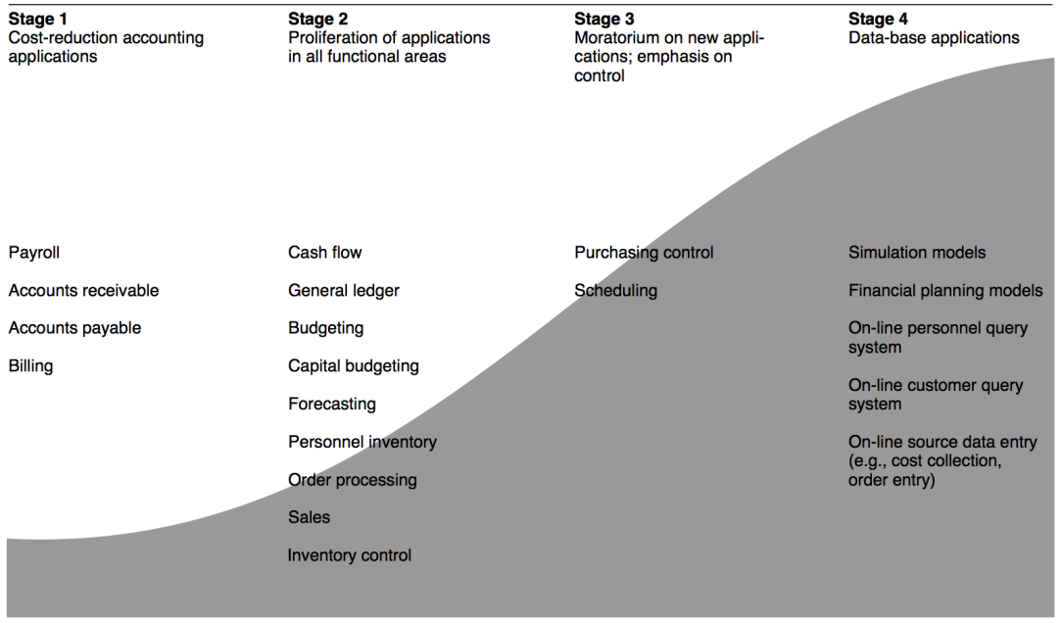
Maturity Model - History
  In 1974 R. L. Nolan proposed four stages of growth for the IT department
  Nolan’s work was then adopted and further developed by several authors:
    McFarlan - Phases of assimilation based on Nolan’s work;
    Sullivan – Reviewed McFarlan’s Model;
    Earl – Based on Sullivan’s Model;
    Galliers – Based on Earl’s Model.
Stages of growth:
Initiation…
Expansion…
Formalization and…
Maturity
(C. F. Gibson, R. L. Nolan, "Managing the Four Stages of EDP Growth,“)

Slide 23
Maturity Model – Examples
Scope | Maturity Levels | # Dimensions | Details
Stanford Data Governance http://dg.stanford.edu/ | 5 | 3 | High
Asset Management http://wiki.tudelft.nl/pub/Main/AndreasLigtvoet/EvaluatingAssetManagementMaturity.pdf | 5 | 4 | High
Records Management http://www.jiscinfonet.ac.uk/tools/maturity-model/ | 4 | 9 | Medium
Digital Asset Management http://dammaturitymodel.org/ | 5 | 4/15 | Medium
Information Governance http://www.arma.org/r2/generally-accepted-br-recordkeeping-principles/metrics | 5 | 8 | High

Slide 24
Stages versus Continuous
Concept: Capability Maturity Models (Continuous Models)
  Consist of a set of capability levels (capability = what things can we do…);
  Relevant for “process maturity” (process = established rules for how should we do things…)
  Example:
Level | Definition
5 | Optimizing process
4 | Predictable process
3 | Established process
2 | Managed process
1 | Performed process
0 | Incomplete process

Slide 25
Stages versus Continuous
  Typical Maturity Models: Focus on Organizational Maturity, which “emphasizes sets of process areas that are intended to define proven stages of process maturity across an organization”. [CMMI V1.3]
  Capability Maturity Models: Focus on Process Capability, which “focuses on establishing baselines and measuring improvement results in each area individually”. [CMMI V1.3]

Slide 26
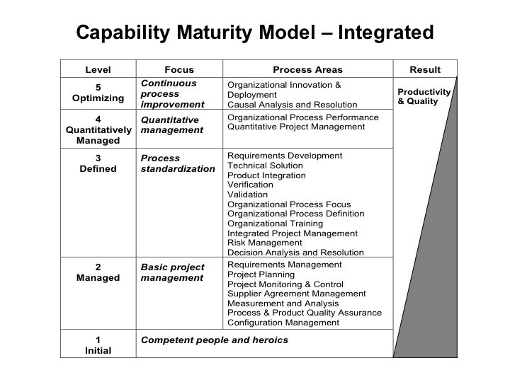
From the CMMI project (focus on software development as a business)

Slide 27
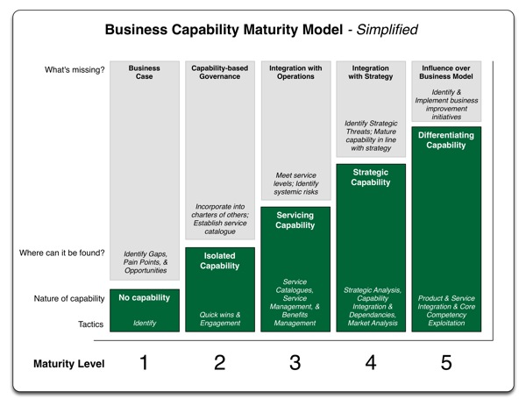
Example: http://managewithoutthem.com/2013/03/04/business-capability-maturity-model-simplified/

Slide 28
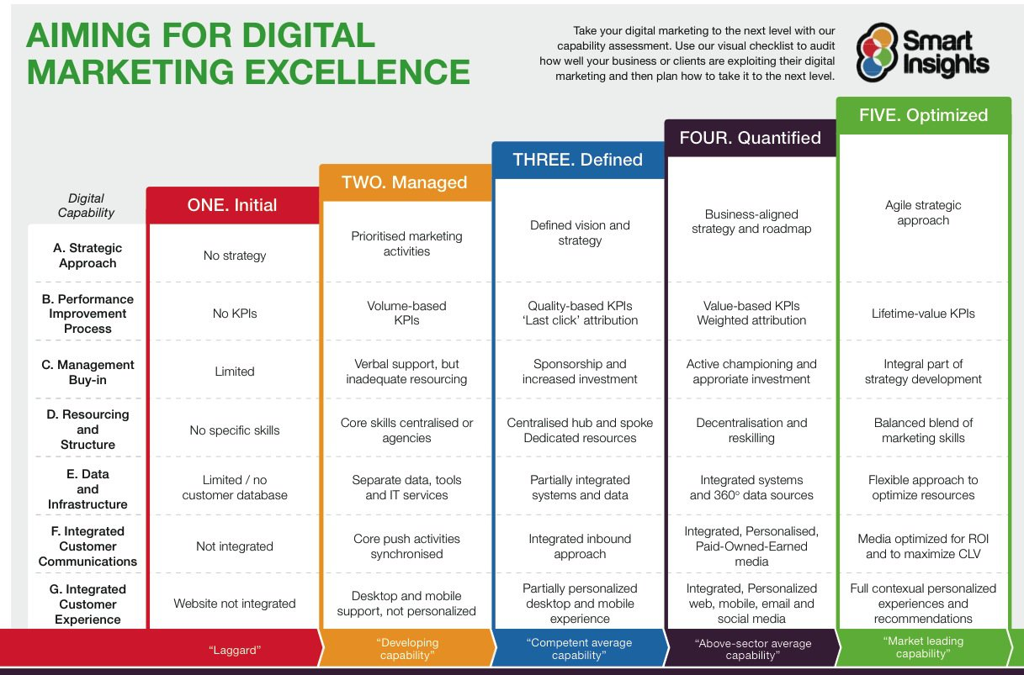
Example:
http://www.smartinsights.com/solution/digital-transformation/attachment/digital-marketing-capabilities-model/

Slide 29
Maturity Models - Assessment Methods
A maturity assessment can be performed:
  As a self-assessment;
  Following an appraisal method such as:
    ISO15504-3 – Guidance on performing and assessment;
    SEI SCAMPI for CMMI:
      CMMI stands for Capability Maturity Model Integration;
      SCAMPI stands for Standard CMMI Appraisal Method for Process Improvement.
    …

Slide 30
Maturity Models - Assessment Methods – ISO 15504
ISO/IEC 15504 is a reference model for maturity models
  It was born as the “Software Process Improvement and Capability Evaluation” (SPICE) in 1993.
  It helps assessors to give an overall determination of organizations’ capabilities for delivering software, systems or services.

Slide 31
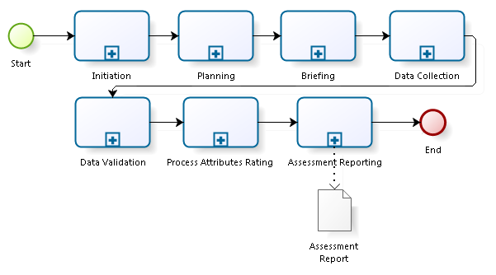
Maturity Models - Assessment Methods – ISO 15504

Slide 32
Maturity Models - Assessment Methods – ISO 15504
Initiation
  Identify the sponsor and defining the purpose of the assessment (why it is being carried out);
  Define the scope of the assessment (which processes are being assessed) and what constraints, if any, apply to the assessment;
  Identify any additional information that needs to be gathered;
  Choose the assessment participants and the assessment team and define the roles of team members and;
  Define all assessment inputs and have them approved by the sponsor.

Slide 33
Maturity Models - Assessment Methods – ISO 15504
Planning
  An assessment plan describing all activities performed in conducting the assessment is developed and documented together with an assessment schedule.
  Using the project scope, resources necessary to perform the assessment are identified and secured.
  The method of collating, reviewing, validating and documenting all of the information required for the assessment is determined.
  Co-ordination with participants in the Organizational Unit is planned.

Slide 34
Maturity Models - Assessment Methods – ISO 15504
Briefing
  Before the data collection takes place, the Assessment Team Leader ensures that the assessment team understands the assessment input, process and output;
  The Organizational Unit is also briefed on the performance of the assessment.

Slide 35
Maturity Models - Assessment Methods – ISO 15504
Data Collection
  Data required for evaluating the processes within the scope of the assessment is collected in a systematic manner.
  The strategy and techniques for the selection, collection, analysis of data and justification of the ratings are explicitly identified and demonstrable.
  Each process identified in the assessment scope is assessed on the basis of objective evidence.

Slide 36
Maturity Models - Assessment Methods – ISO 15504
Data Collection
  The objective evidence gathered for each attribute of each process assessed must be sufficient to meet the assessment purpose and scope.
  Objective evidence that supports the assessors’ judgment of process attribute ratings is recorded and maintained in the Assessment Record.
  This Record provides evidence to substantiate the ratings and to verify compliance with the requirements.

Slide 37
Maturity Models - Assessment Methods – ISO 15504
Data Validation
  Actions are taken to ensure that the data is accurate and sufficiently covers the assessment scope, including:
    seeking information from first hand, independent sources;
    using past assessment results;
    and holding feedback sessions to validate the information collected.

Slide 38
Maturity Models - Assessment Methods – ISO 15504
Process Attribute Rating
  For each process assessed, a rating is assigned for each process attribute up to and including the highest capability level defined in the assessment scope.
    The rating is based on data validated in the previous activity.
  Traceability shall be maintained between the objective evidence collected and the process attribute ratings assigned.
  For each process attribute rated, the relationship between the indicators and the objective evidence shall be recorded.

Slide 39
Maturity Models - Assessment Methods – ISO 15504
Assessment Reporting
  The results of the assessment are analyzed and presented in a report.
  The report also covers any key issues raised during the assessment such as observed areas of strength and weakness and findings of high risk.

Slide 40
Maturity Models - Assessment Methods – SCAMPI for CMMI
The Capability Maturity Model Integration (CMMI) was initially developed by the US Department of Defense and the National Defense Industrial Association (NDIA).
In 2000 the Software Engineering Institute (SEI) at Carnegie Mellon University took stewardship and produced the first integrated CMMI models, training material and the companion appraisal:
  SCAMPI - Standard CMMI Appraisal Method for Process Improvement

Slide 41
Maturity Models - Assessment Methods – SCAMPI for CMMI
The CMMI Suite contains information and guidance to help an organization improve its processes.
The CMMI models comprise:
  Materials that help in the evaluation of organization processes, which provides essential information to the management, support and technical activities;
  Materials which help improve process performance, which provides information which can be used to increase the capability level of an organization’s activities.

Slide 42
Maturity Models - Assessment Methods – SCAMPI for CMMI
There is also material to another constellation, Services, which is intended to support organizations that primarily deliver services rather than products.
One important aspect to take in consideration is that CMMI uses both the typical maturity levels, and the capability levels through:
  A Staged Representation, for the typical maturity levels;
  A Continuous Representation, for the capability levels.

Slide 43
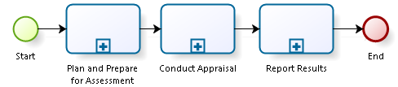
Maturity Models - Assessment Methods – SCAMPI for CMMI
The Standard CMMI Appraisal Method for Process Improvement details the method to assess the processes that are described in the three constellations of CMMI.

Slide 44
Maturity Models - Assessment Methods – SCAMPI for CMMI
Plan and Prepare for Assessment
  Appraisal planning starts with understanding the sponsor’s objectives, requirements, and constraints;
  All planning, preparation, execution, and reporting of results proceed from this initial activity;
  Because of the significant investment and logistical planning involved, considerable iteration and refinement of planning activities should be expected in this phase;
  With each subsequent phase, the amount of iteration will decrease as data are collected, analyzed, refined, and translated into findings of significance relative to the model.

Slide 45
Maturity Models - Assessment Methods – SCAMPI for CMMI
Conduct Appraisal
  The appraisal team focuses on collecting data from the appraised organization to judge the extent to which the model is implemented.
  Integral to this approach is the concept of coverage, which implies two things:
    The collection of sufficient data for each model component within the model scope selected by the sponsor;
    Obtaining a representative sample of ongoing processes.

Slide 46
Maturity Models - Assessment Methods – SCAMPI for CMMI
Report Results
  The appraisal team provides the findings and ratings to the appraisal sponsor and the organization.
  These artifacts become part of the appraisal record, which becomes protected data in accordance with the appraisal disclosure statement.
  A completed appraisal data package, which includes a subset of the contents of the appraisal record, is provided to the SEI. The SEI adds the appraisal data to confidential databases, and provides overall profiles of the community on a periodic basis.

Slide 47
Summary
A Maturity Model is a method used to develop and refine organization’s processes. It identifies a path of levels, meaning increasingly organized and systematically more mature processes.
Maturity models can be staged (the typical maturity levels) or continuous (capability levels).
There are plenty of maturity models for the most diverse domains, developed by the industry, academia, …
To assess the maturity levels, organizations can opt for self-assessment or follow an existing assessment method.

Slide 48
Questions?
Further Reading:
  SEI CMMI:
    Development: http://www.sei.cmu.edu/reports/10tr033.pdf
    Acquisition: http://www.sei.cmu.edu/reports/10tr032.pdf
    Service: http://www.sei.cmu.edu/reports/10tr034.pdf
  SCAMPI for CMMI: http://www.sei.cmu.edu/reports/11hb001.pdf
  ISO15504 (Paid): Http://www.iso.org/iso/home/store/catalogue_tc/catalogue_detail.htm?csnumber=37454

Slide 49
E-ARK Information Governance Maturity Model

Slide 50
Motivation
Developed in the scope of the EC funded project E-ARK
Assess the pilots in the project
  At an initial phase, before application of the outputs of the project
  At the end, after application of the outputs of the project
Show that the outputs of the project effectively help in the enhancement of Information Governance practice in organizations
Notes:
Guidelines: directrizes
Funding: financiar

Slide 51
COMPLETED
FUTURE WORK
From:
Procedure model for developing maturity models [J. Becker, R. Knackstedt, J. Poppelbuß. “Developing Maturity Models for IT Management – A Procedure Model and its Application”]

Slide 52
Maturity Model - Development Method
1. Problem Definition
2. Comparison of existing maturity models
3. Determination of the development strategy
4. Iterative maturity model development
5. Conception of transfer and evaluation
6. Implementation of transfer media
7. Evaluation
8. Repeat steps 4 to 7 until satisfaction

Slide 53
Maturity Model - Development Method
Requirements (detailed in the development method)
  R1 – A Comparison with existing maturity models (…);
  R2 – Iterative Procedures are followed (…);
  R3 – (…) maturity model should pass through an iterative Evaluation step;
  R4 – (…) maturity models should follow a Multi-methodological Procedure (…);
  R5 – (…) there should be a clear Identification of Problem Relevance (...);
  R6 – Problem Definition (…);
  R7 – (…) Targeted Presentation of Results (…);
  R8 – (…) maturity model must include Scientific Documentation (…).
Notes:
Holistico:
Promover IG como parte integral da organização em que o seu entendimento é semelhante em toda a organização

Slide 54
Maturity Model - Problem Definition
Define Information Governance as a framework to optimize the value of information to the actors involved
Promote IG as an holistic concept
Assure that the application of IG policies can be measured and consequently refined based on the evaluation
Notes:
Holistico:
Promover IG como parte integral da organização em que o seu entendimento é semelhante em toda a organização

Slide 55
Maturity Model - Development Strategy
Create our maturity model architecture (i.e. define stages and dimensions)
Use literature analysis to populate our levels
ISO16363 (TRAC)
ISO14721 (OAIS)
ISO20652 (PAIMAS)
ISO15489
ISO30300/1
MoReq2010
ISO/IEC 38500
ISO11442
ISO13008
ISACA – COBIT
ITIL
TOGAF
Notes:
PAIMAS Producer-archive interface -- Methodology abstract standard
ISO 15489: Information and documentation – Records management;
ISO 30300: Information and documentation – Management systems for records – Fundamentals and vocabulary;
ISO 30301: Information and documentation – Management systems for records – Requirements;
ISO 11442: Technical product documentation – Document management;
ISO 13008: Information and documentation – Digital records conversion and migration process;

Slide 56
Maturity Model - Development Strategy
For the first iteration we used the ISO16363, ISO14721 and ISO20652 to create a maturity model.
In the second version further reference documents will be analysed and considered for the maturity model, if deemed relevant.
Notes:
ISO 15489: Information and documentation – Records management;
ISO 30300: Information and documentation – Management systems for records – Fundamentals and vocabulary;
ISO 30301: Information and documentation – Management systems for records – Requirements;
ISO 11442: Technical product documentation – Document management;
ISO 13008: Information and documentation – Digital records conversion and migration process;

Slide 57
Maturity Model - Development Strategy
Dimensions
  Management
  “The term management refers to all the activities that are used to coordinate, direct, and control an organization. ISO 9000 uses the term top management to refer to people.” [ISO9000]

Slide 58
Maturity Model - Development Strategy
Dimensions
  Processes
  “A process is a set of activities that are interrelated or that interact with one another. Processes use resources to transform inputs into outputs. Processes are interconnected because the output from one process becomes the input for another process. In effect, processes are “glued” together by means of such input output relationships.” [ISO9000]

Slide 59
Maturity Model - Development Strategy
Dimensions
  Infrastructure
  “The term infrastructure refers to the entire system of facilities, equipment, and services that an organization needs in order to function. According to ISO 9001, Part 6.3, the term infrastructure includes buildings and workspaces (including related utilities), process equipment (both hardware and software), support services (such as transportation and communications), and information systems.” [ISO9000]

Slide 60
Maturity Model - Development Strategy
Level 1 (Initial)
  There is some effort regarding information governance;
  IG Processes are ad-hoc and unorganized;
Level 2 (Managed)
  There is evidence that Information Governance is being managed;
  Information Governance is implemented by individuals and not as part of the organization culture;
  Methods and Procedures used are not repeatable;
  Responsabilities are partially identified;

Slide 61
Maturity Model - Development Strategy
Level 3 (Defined)
  There is a concern regarding information governance;
  IG Processes are defined;
  Responsabilities are fully identified.
Level 4 (Quantitatively Managed)
  Information Governance is part of the mission of the organization and is used to get competitive advantage;
  IG Processes are not only defined but monitored and evaluated to assure efficiency and effectivness;
  The organization is a reference of IG good practices.
Notes:
supervisionado

Slide 62
Maturity Model - Development Strategy
Level 5 (Optimizing)
  The organization promotes IG as a transversal strategy;
  The Enterprise Architecture of the organization is well defined and IG plays a pro-active role in all areas;
  The organization actively contributes to the innovation of IG;
  The organization is recognized as a partner for IG innovation;
These levels were adopted from the SEI CMMI, which has been working on these levels for decades and is considered one of the main references in maturity models.
Notes:
supervisionado

Slide 63
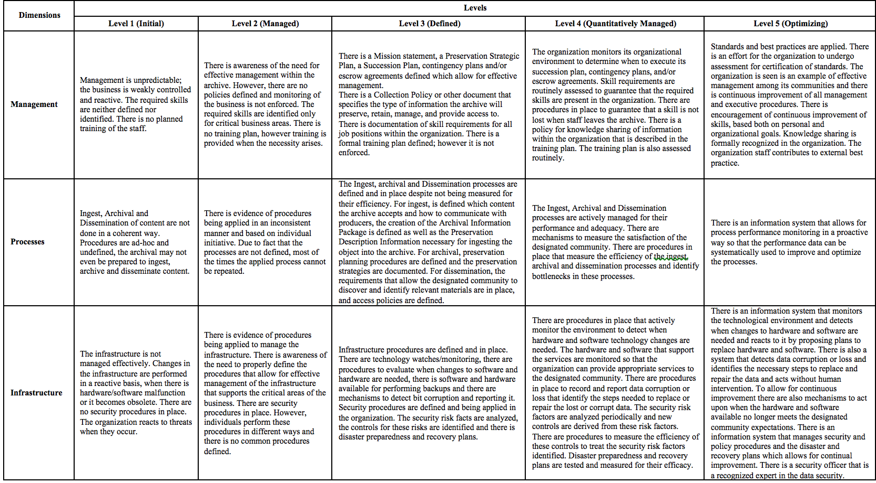
Maturity Model - Development Strategy

Slide 64
First Assessment
In order to assess the E-ARK pilots on their maturity regarding information governance, the project has adopted a self-assessment process.
In this self-assessment process:
  A questionnaire is provided to the organization to be assessed which they complete to the best of their knowledge.
  Then the results are analysed by the assessment team and an assessment report is provided to the organization.
Notes:
supervisionado

Slide 65
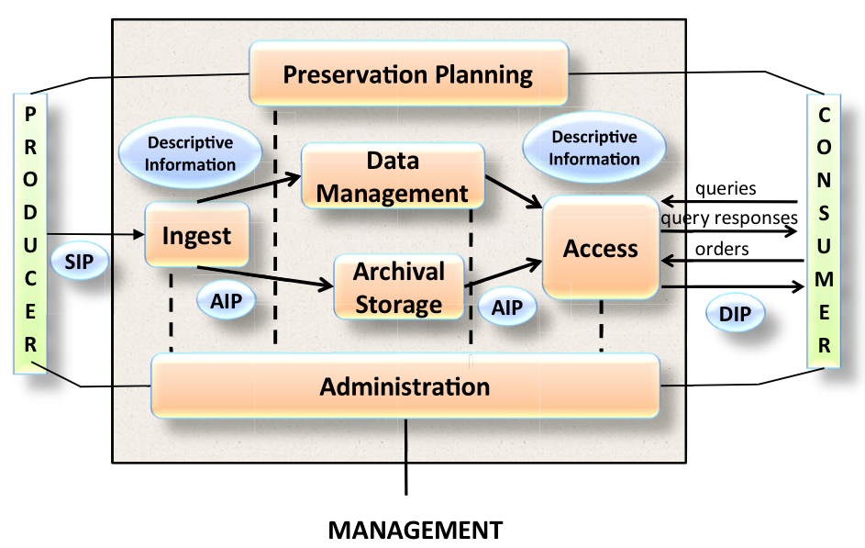
First Assessment
OAIS

Slide 66
First Assessment
The questionnaire is comprised of five capabilities, then each capability contains a set of questions.
Notes:
supervisionado

Slide 67
First Assessment
Each question was presented in the following way:
  Question: Which details the question itself;
  Objective: Which details the objective of that question, what knowledge the question intends to capture;
  Notes: Which either clarifies some aspects and/or terms of the question or details examples of evidence to substantiate the answer for the question;
  Terms: Which identifies the terms that are detailed in EVOC. EVOC is the vocabulary manager which makes part of the knowledge centre being developed in the E-ARK project.
  Answers: Which depicts the five possible answers to the question;
  Comment: A field to provide additional comments to an answer.
Notes:
supervisionado

Slide 68
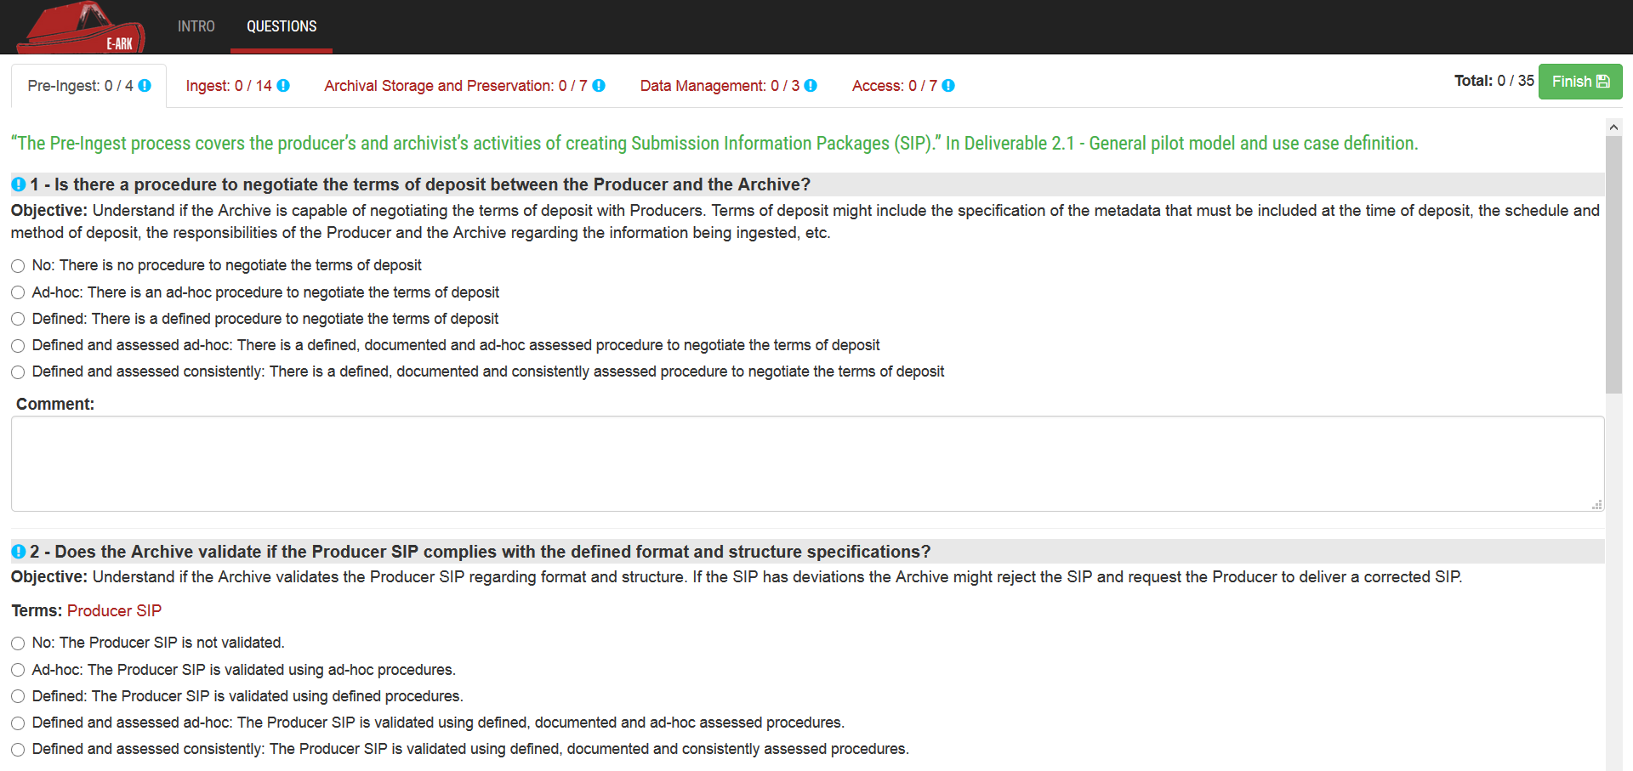
First Assessment
Notes:
supervisionado

Slide 69
First Assessment
It is important to note that for the purpose of this deliverable we are only assessing the “Processes” dimension of the Information Governance Maturity Model.
This is due to the fact that the E-ARK pilots do not have an organizational background which would allow assessing the other two dimensions.
The results are calculated as an average of the maturity levels of the questions for each capability, this average was then rounded down.
Notes:
supervisionado

Slide 70
Pilots Definition
Pilot 1: SIP creation of relational databases
Pilot 2: SIP creation and ingest of record
Pilot 3: Ingest from government agencies
Pilot 4: Business Archives
Pilot 5: Preservation and access to records with geodata
Pilot 6: Seamless integration between a live document management system and a long-term digital archiving and preservation services
Pilot 7: Access to databases

Slide 71
First Assessment
Pilot 1: SIP creation of relational databases (Danish National Archives)
Notes:
supervisionado

Slide 72
First Assessment
Pilot 1: SIP creation of relational databases (Danish National Archives)
Notes:
supervisionado

Slide 73
First Assessment
Pilot 1: SIP creation of relational databases (Danish National Archives)
  Weak Points
    Capability: Ingest / Question: 12 / Maturity Level: 1 - This question is related with procedures to create and manage AIP classes. This is the only question at maturity level 1 in the ingest capability, one of the focus of the pilot and as such it should be addressed.
    Capability: Ingest / Question: 13 / Maturity Level: 3 - This question is related with the AIP unique identifiers convention. This is the only question at maturity level 3 in the ingest capability, together with question 12 these are the questions that are below the calculated maturity level.
Notes:
supervisionado

Slide 74
First Assessment
Pilot 1: SIP creation of relational databases (Danish National Archives)
  Weak Points
    Capability: Archival Storage and Preservation / Question: 22 / Maturity Level: 2 - This question is related with the AIP Designated community requirements. However this procedure is not correctly defined, documented and assessed.
    Capability: Access / Question: 34 / Maturity Level: 3 - This question is related with Access Data Problem Reports. This is the only question at maturity level 3 and as such it should be enhanced to meet the calculated maturity level for the access capability. Despite this, access is not one of the focus capabilities of the pilot.
Notes:
supervisionado

Slide 75
First Assessment
Pilot 2: SIP creation and ingest of records (National Archives of Norway)
Notes:
supervisionado

Slide 76
First Assessment
Pilot 2: SIP creation and ingest of records (National Archives of Norway)
Notes:
supervisionado

Slide 77
First Assessment
Pilot 2: SIP creation and ingest of records (National Archives of Norway)
  Weak Points
    Capability: Pre-Ingest / Question: 4 / Maturity Level: 1 – This question is related to the enhancement of a producer SIP. The answer shows that the producer SIP is not enhanced. The answer provided to this aspect hinders the achievement of maturity level 5 for this capability.
    Capability: Ingest / Question: 5 / Maturity Level: 1 – This question is related with the creation of fonds. This is the only aspect of the ingest capability that is at maturity level 1.
Notes:
supervisionado

Slide 78
First Assessment
Pilot 2: SIP creation and ingest of records (National Archives of Norway)
  Weak Points
    Capability: Ingest / Question: 14 / Maturity Level: 2 – This question is related to the preservation description information acquisition procedures. According to the comment provided for this question this is performed manually at the moment but there is a planned effort to automatize these procedures.
    Capability: Ingest / Question: 16 / Maturity Level: 2 – This question is related to the AIP content information testing procedures. According to the comment provided for this question during testing of the SIP, one of the criteria is to make sure the AIP is usable for access.
Notes:
supervisionado

Slide 79
First Assessment
Pilot 2: SIP creation and ingest of records (National Archives of Norway)
  Weak Points
    Capability: Archival Storage and Preservation / Question: 22 / Maturity Level: 1 – This question is related to the AIP Designated community requirements. Maintaining the AIP requirements aligned with the designated community needs is important to guarantee that the archive holdings remain relevant to the designated community.
    Capability: Archival Storage and Preservation / Question: 24 / Maturity Level: 2 – This question is related to SIP linking/resolution services. This means that the system that provides reliable linking/resolution services in order to find a uniquely identified object, regardless of its physical location so that all actions related to an AIP can be traced over time, system and storage changes is not defined, documented and assessed.
Notes:
supervisionado

Slide 80
First Assessment
Pilot 3: Ingest from government agencies (National Archives of Estonia)
Notes:
supervisionado

Slide 81
First Assessment
Pilot 3: Ingest from government agencies (National Archives of Estonia)
Notes:
supervisionado

Slide 82
First Assessment
Pilot 3: Ingest from government agencies (National Archives of Estonia)
  Weak Points
    Capability: Ingest / Question: 12 / Maturity Level: 1 – This question is related to AIP parsing. The AIP classes are important to understand the variety of information that is stored and also to enable correct parsing of all information stored in the Archive.
    Capability: Ingest / Question: 16 / Maturity Level: 2 – This question is related with the AIP content information testing procedures. This is important to guarantee that the ingest objects can be found, understood and used by the designated community.
Notes:
supervisionado

Slide 83
First Assessment
Pilot 3: Ingest from government agencies (National Archives of Estonia)
  Weak Points
    Capability: Archival Storage and Preservation / Question: 22 / Maturity Level: 1 – This question is related with AIP designated community requirements. Maintaining the AIP requirements aligned with the designated community needs is important to guarantee that the archive holdings remain relevant to the designated community.
    Capability: Archival Storage and Preservation / Question: 23 / Maturity Level: 2 – This question is related with the independent mechanism for content integrity checking. This means that the current mechanism for integrity checking is not properly defined, documented or assessed. An independent mechanism for content integrity checking is important as it enables independent and external audits.
Notes:
supervisionado

Slide 84
First Assessment
Pilot 4: Business archives (National Archives of Estonia, Estonian Business Archives)
Notes:
supervisionado

Slide 85
First Assessment
Pilot 4: Business archives (National Archives of Estonia, Estonian Business Archives)
Notes:
supervisionado

Slide 86
First Assessment
Pilot 4: Business archives (National Archives of Estonia, Estonian Business Archives)
  Weak Points
    Capability: Archival Storage and Preservation / Question: 19 / Maturity Level: 1 – This question is related to the AIP Storage Procedures. This question is part of the archival storage and preservation capability which is one of the capabilities to be explored the pilot. Together with question 22 and 25 these are the only aspects from that capability at maturity level 1 and require immediate attention.
    Capability: Archival Storage and Preservation / Question: 22 / Maturity Level: 1 – This question is related to the AIP Designated community requirements. This question is part of the archival storage and preservation capability which is one of the capabilities to be explored the pilot. Together with question 19 and 25 these are the only aspects from that capability at maturity level 1 and require immediate attention.
Notes:
supervisionado

Slide 87
First Assessment
Pilot 4: Business archives (National Archives of Estonia, Estonian Business Archives)
  Weak Points
    Capability: Archival Storage and Preservation / Question: 25 / Maturity Level: 1 – This question is related to tools and resources to provide representation informationThis question is part of the archival storage and preservation capability which is one of the capabilities to be explored the pilot. Together with question 19 and 22 these are the only aspects from that capability at maturity level 1 and require immediate attention.
Notes:
supervisionado

Slide 88
First Assessment
Pilot 5: Preservation and access to records with geodata (National Archives of Slovenia)
Notes:
supervisionado

Slide 89
First Assessment
Pilot 5: Preservation and access to records with geodata (National Archives of Slovenia)
Notes:
supervisionado

Slide 90
First Assessment
Pilot 5: Preservation and access to records with geodata (National Archives of Slovenia)
  Weak Points
    Capability: Pre-Ingest / Question: 4 / Maturity Level: 3 - This question is related to the enhancement of a producer SIP. The answer provided to this aspect hinders the achievement of maturity level 5 for this capability.
    Capability: Data Management / Question: 28 / Maturity Level: 1 – This question is related with the bi-directional linkage between the AIP and descriptive information. The answer provided to this aspect hinders the achievement of maturity level 3 for this capability.
Notes:
supervisionado

Slide 91
First Assessment
Pilot 5: Preservation and access to records with geodata (National Archives of Slovenia)
  Weak Points
    Capability: Access / Question: 32 / Maturity Level: 1 – This question is related with access failures and errors. This aspect is important as it makes part of a capability that is the focus of the pilot and is the only aspect of this capability at maturity level 1.
Notes:
supervisionado

Slide 92
First Assessment
Pilot 6: Seamless integration between a live document management system and a long-term digital archiving and preservation service (KEEP SOLUTIONS)
Notes:
supervisionado

Slide 93
First Assessment
Pilot 6: Seamless integration between a live document management system and a long-term digital archiving and preservation service (KEEP SOLUTIONS)
Notes:
supervisionado

Slide 94
First Assessment
Pilot 6: Seamless integration between a live document management system and a long-term digital archiving and preservation service (KEEP SOLUTIONS)
  Weak Points
    Capability: Pre-Ingest / Question: 4 / Maturity Level: 3 - This question is related to the enhancement of a producer SIP. The answer provided to this aspect hinders the achievement of maturity level 3 for all question of this capability.
    Capability: Ingest / Question: 9 / Maturity Level: 1 – This question is related to legal rights. This is the only aspect at maturity level 1 in the ingest capability, which is one of the focus capabilities of the pilot and requires immediate attention.
Notes:
supervisionado

Slide 95
First Assessment
Pilot 6: Seamless integration between a live document management system and a long-term digital archiving and preservation service (KEEP SOLUTIONS)
  Weak Points
    Capability: Archival Storage and Preservation / Question: 22 / Maturity Level: 1 - This question is related with AIP designated community requirements. This question is part of the archival storage and preservation capability which is part of the focus of the pilot. Together with question 25 these are the only aspects from that capability at maturity level 1 and require immediate attention.
Notes:
supervisionado

Slide 96
First Assessment
Pilot 6: Seamless integration between a live document management system and a long-term digital archiving and preservation service (KEEP SOLUTIONS)
  Weak Points
    Capability: Access / Question: 32 / Maturity Level: 1 - This question is related with access failures and errors. This question is part of the access capability which is part of the focus of the pilot. Together with question 31 these are the only aspects from that capability at maturity level 1 and require immediate attention.
Notes:
supervisionado

Slide 97
First Assessment
Pilot 7: Access to databases (National Archives of Hungary)
Notes:
supervisionado

Slide 98
First Assessment
Pilot 7: Access to databases (National Archives of Hungary)
Notes:
supervisionado

Slide 99
First Assessment
Pilot 7: Access to databases (National Archives of Hungary)
  Weak Points
    Capability: Ingest / Question: 5 / Maturity Level: 2 - This question is related with the creation of fonds. This question is part of the ingest capability which is part of the focus of the pilot. Together with question 8 and 16 these are the only aspects from that capability at maturity level 2 and require immediate attention.
    Capability: Ingest / Question: 8 / Maturity Level: 2 – This question is related to the Ingest actions and administration processes records. This question is part of the ingest capability which is part of the focus of the pilot. Together with question 5 and 16 these are the only aspects from that capability at maturity level 2 and require immediate attention.
Notes:
supervisionado

Slide 100
First Assessment
Pilot 7: Access to databases (National Archives of Hungary)
  Weak Points
    Capability: Ingest / Question: 16 / Maturity Level: 2 - This question is related with the AIP content information testing procedures. This question is part of the ingest capability which is part of the focus of the pilot. Together with question 5 and 8 these are the only aspects from that capability at maturity level 2 and require immediate attention.
    Capability: Archival Storage and Preservation / Question: 22 / Maturity Level: 2 – This question is related with the AIP Designated community requirements. This is the only aspect from the archival storage and preservation capability at maturity level 2, and hinders the achievement of maturity level 4 for this capability.
Notes:
supervisionado

Slide 101
First Assessment
Pilot 7: Access to databases (National Archives of Hungary)
  Weak Points
    Capability: Access / Question: 32 / Maturity Level: 1 - This question is related with access failures and errors. This question is part of the access capability which is part of the focus of the pilot. Together with question 33 these are the only aspects from that capability at maturity level 1 and require immediate attention.
    Capability: Access / Question: 33 / Maturity Level: 1 – This question is related with Access Data Reports. This question is part of the access capability which is part of the focus of the pilot. Together with question 32 these are the only aspects from that capability at maturity level 1 and require immediate attention.
Notes:
supervisionado

Slide 102
Overall Pilots Assessment

Slide 103
Future Work
Continue analysing relevant sources of literature to refine the E-ARK Information Governance Maturity Model.
Continue refining the assessment questionnaire, based on the feedback received during the initial assessment of the pilots.
Use the lessons to propose a generic Information Governance Maturity Model.

Slide 104
Questions?
E-ARK Reports:
  E-ARK D7.1 (http://www.eark-project.com/resources/project-deliverables/19-d71-e-ark-a-maturity-model-for-information-governance-initial-version)
  E-ARK D7.2 (http://www.eark-project.com/resources/project-deliverables/46-d72initassess)

